Slide 1

Superstore Performance
& Forecasting Summary
An in-depth evaluation of total revenue, profit margins, segment distribution, seasonal trends, and predictive forecasting.

Slide 2




Key Performance Indicators
$2.26M
$0.41M
4,922
54K
TOTAL CUMULATIVE SALES
TOTAL NET PROFIT
TOTAL ORDERS PROCESSED
TOTAL QUANTITY SOLD
Strong Overall Profit Margin: Superstore achieved an overall profit margin of 18.1% across $2.26M in total sales volume.
High Fulfillment Volume: 54,000 product units were fulfilled across 4,922 distinct customer orders.
Consistent Revenue Engine: Operational metrics confirm robust baseline demand across primary sales territories.

Slide 3
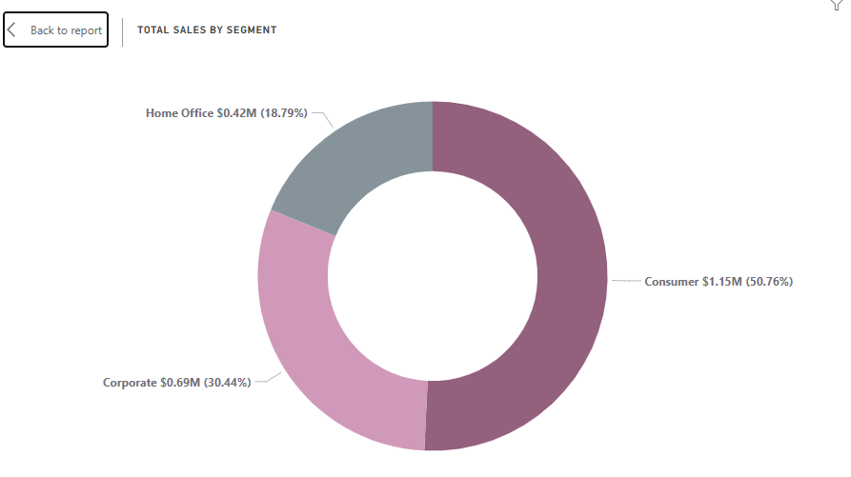
Sales by Customer Segment
The Consumer segment accounts for over half of total store revenue ($1.15M), while Corporate B2B purchasing represents the second largest share at $0.69M.

Slide 4
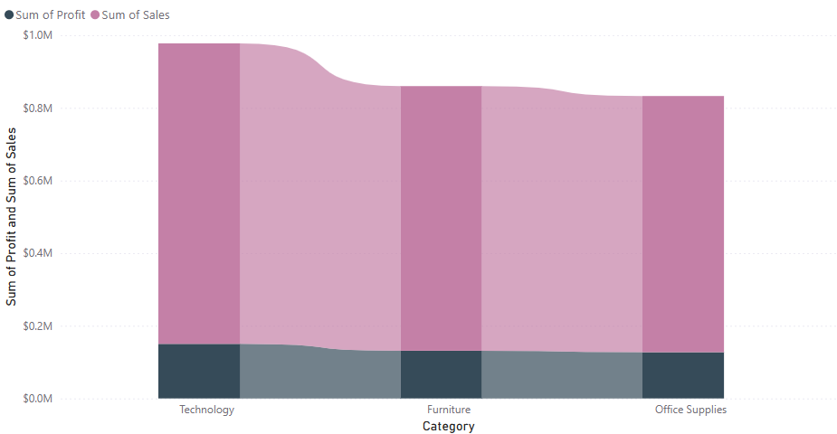
Category Revenue & Profitability
Technology delivers both the highest revenue volume and profit margin share. Furniture generates substantial gross revenue, but experiences squeezed margins due to shipping and discounting.

Slide 5
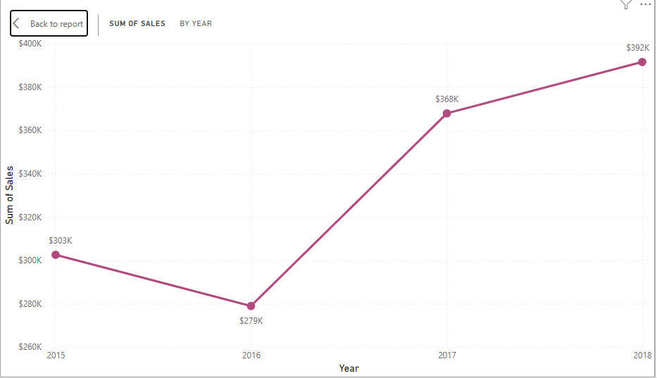
Annual Sales Growth Trajectory
Following a slight dip in 2016 ($0.46M), sales experienced a major expansion in 2017 (+30.4%) and accelerated to $0.72M in 2018 (+20.0%), representing a 50% revenue gain over 4 years.

Slide 6
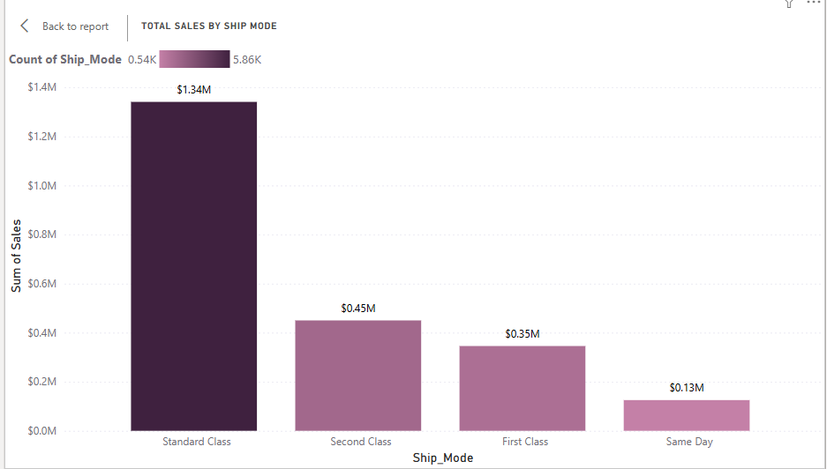
Shipment Mode Preferences
Standard Class is overwhelmingly preferred by customers due to lower cost. Faster options (First Class & Same Day) account for 20% combined, presenting an opportunity for express shipping promotions.

Slide 7






Quarterly Sales Dynamics
Q1 - Q2 Ramp Up
Q3 Expansion
Q4 Holiday Peak
Sales start lower in Q1 ($0.35M) during post-holiday lull, then gain momentum in Q2 ($0.44M) with spring replenishment.
Quarter 3 accelerates to $0.60M driven by Back-to-School shopping and corporate Q3 budget allocation.
Quarter 4 dominates overall performance reaching $0.87M, accounting for nearly 38% of total annual sales volume.

Slide 8
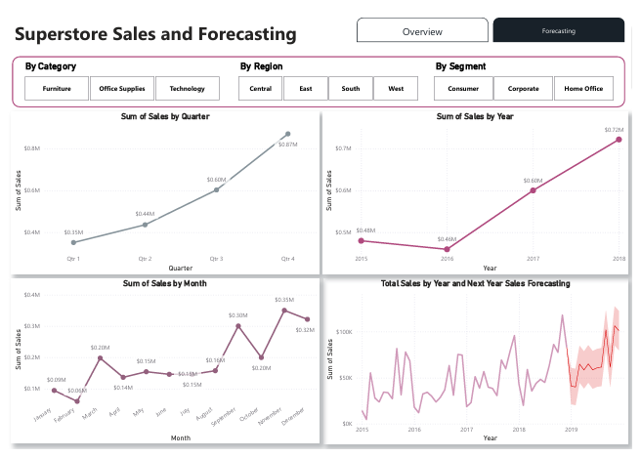
Predictive Sales Forecasting
Positive Projected Outlook: Predictive modeling forecasts continued year-over-year revenue expansion heading into 2019.
Monthly Fluctuation Pattern: Historical monthly spikes in September ($0.30M) and November ($0.35M) are predicted to repeat.
Confidence Range: Forecasted monthly revenue projects between $50K to $110K with steady upper bounds.
Operational Strategy: Supply chain inventory must ramp up 60 days prior to Q4 demand surges.

Slide 9
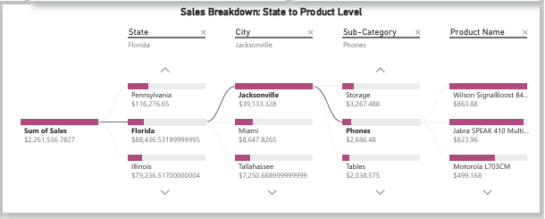
Sales Overview Breakdown
Geographic & Product Drilldown
The dashboard decomposition analysis reveals key regional performance drivers across top performing states like Pennsylvania ($116K), Florida ($88.4K), and Illinois ($79.2K).
Key sub-categories such as Phones, Storage, and Tables represent significant revenue anchors in Jacksonville, Miami, and Tallahassee markets.

Slide 10




Strategic Action Plan
Phase 2: Q2
Phase 4: Q4
Margin adjustments on Furniture & expand Tech promotions.
Execute peak holiday marketing campaigns & express shipping.
Phase 1: Q1
Phase 3: Q3
Optimize Inventory & rebalance stock following peak Q4 sales.
Pre-load stock for autumn demand & corporate supply drives.

Slide 11
Questions & Discussion
Thank you for your time. Let's discuss strategic implementation.

